Slide 1

HR DATA ANALYSIS - SQL
SUBMISSION BY:-
ABHISHEK SUNEJA

Slide 2
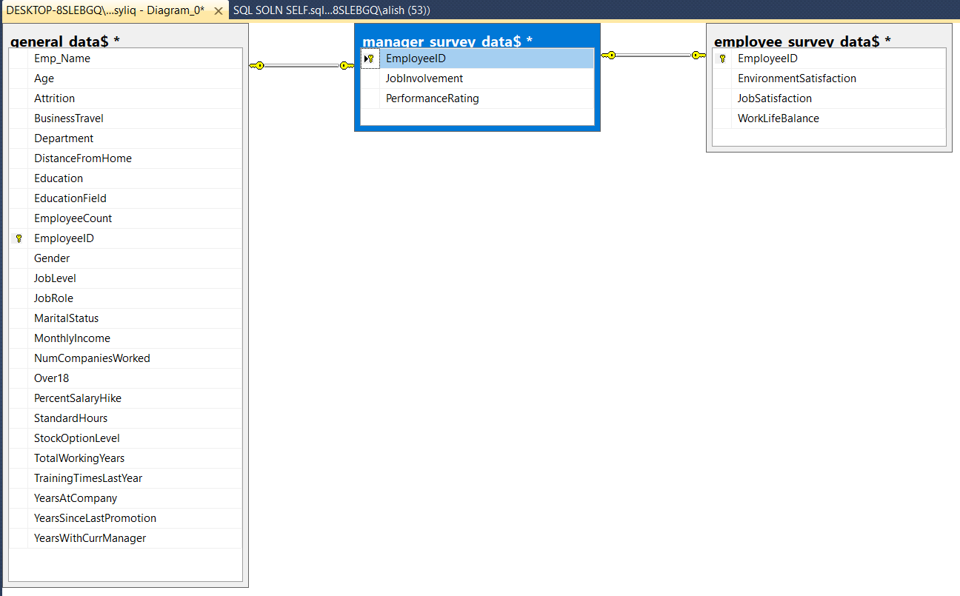
AIM: AS A DATA ANALYST INTERN, DRIVING INSIGHTS AND ANALYZING HR DATASET FOR PSYLIQ
ER DIAGRAM

Slide 3
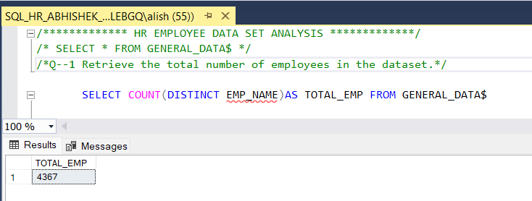
Q-1 Retrieve the total number of employees in the dataset.
WE HAVE DATA OF 4367 EMPLOYEES

Slide 4
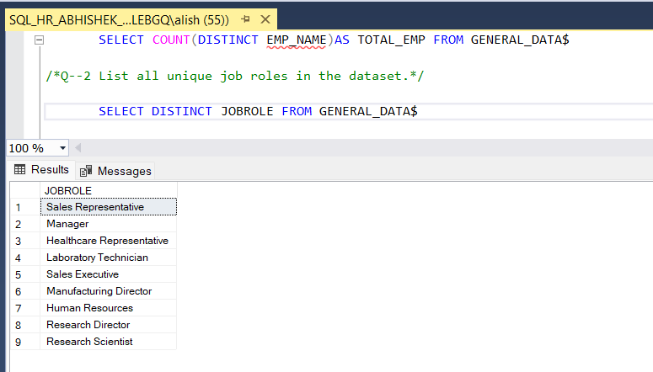
Q-2 List all unique job roles in the dataset.
THERE ARE 9 DIFFERENT JOB ROLES4367 EMPLOYEES

Slide 5
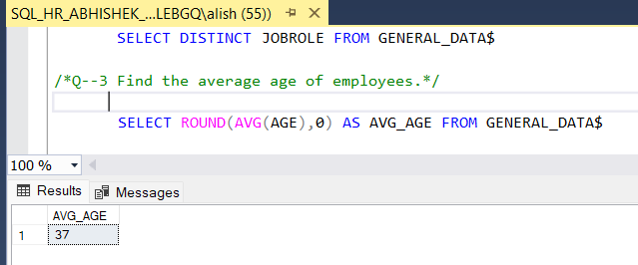
Q-3 Find the average age of employees.
AVERAGE AGE OF EMPLOYEES IS 37

Slide 6
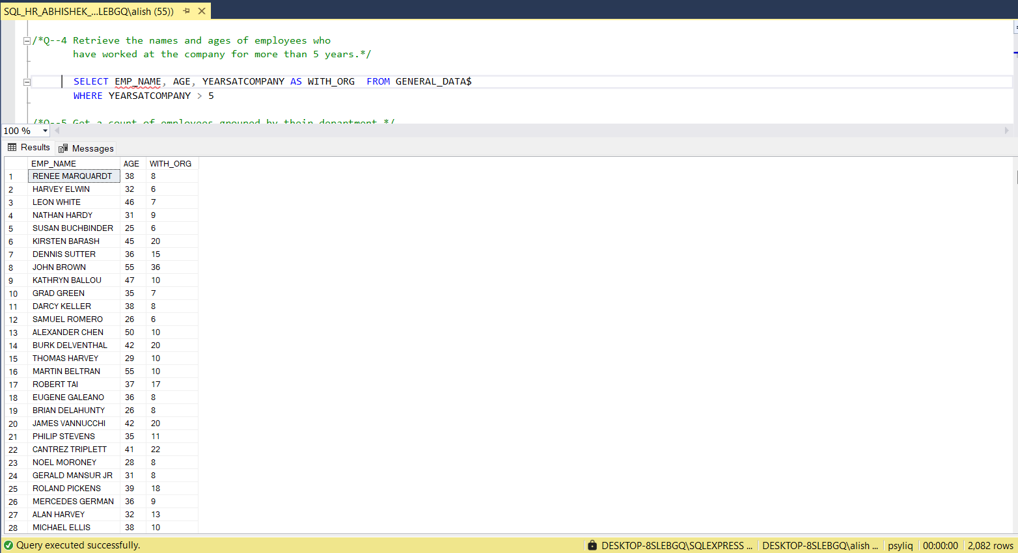
Q-4 Retrieve the names and ages of employees who have worked at the company for more
than 5 years.
THERE ARE 2082 EMPLOYEES FOR MORE THAN 5 YEARS IN THE COMPANY

Slide 7
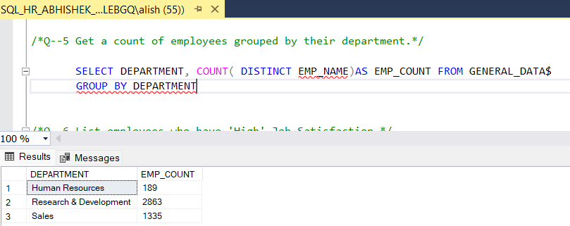
Q-5 Get a count of employees grouped by their department.
THREE DIFFERENT DEPARTMENTS ARE THERE AND RESPECTIVE NO OF
DISTINCT EMPLOYEES IN EACH.

Slide 8
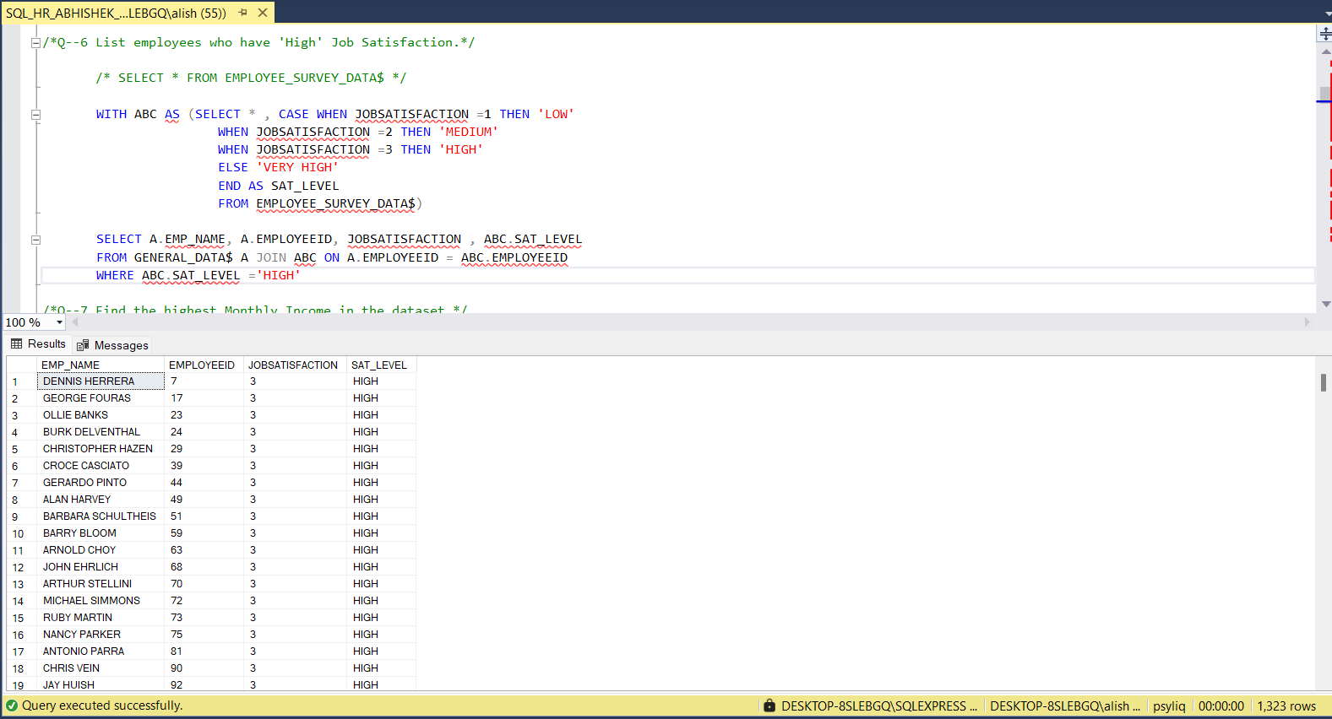
Q-6 List employees who have 'High' Job Satisfaction.
1323 EMPLOYEES ARE THERE
WITH ‘HIGH’ JOB
SATISFACTION RATE

Slide 9
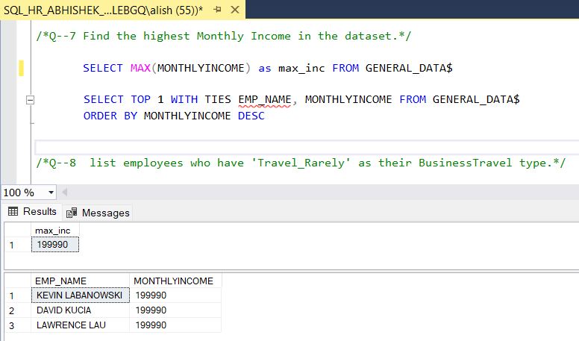
Q-7 Find the highest Monthly Income in the dataset.
199990 IS THE HIGHEST SALARY AND 3 EMPLOYEES
HAVE THE SAME SALARY

Slide 10
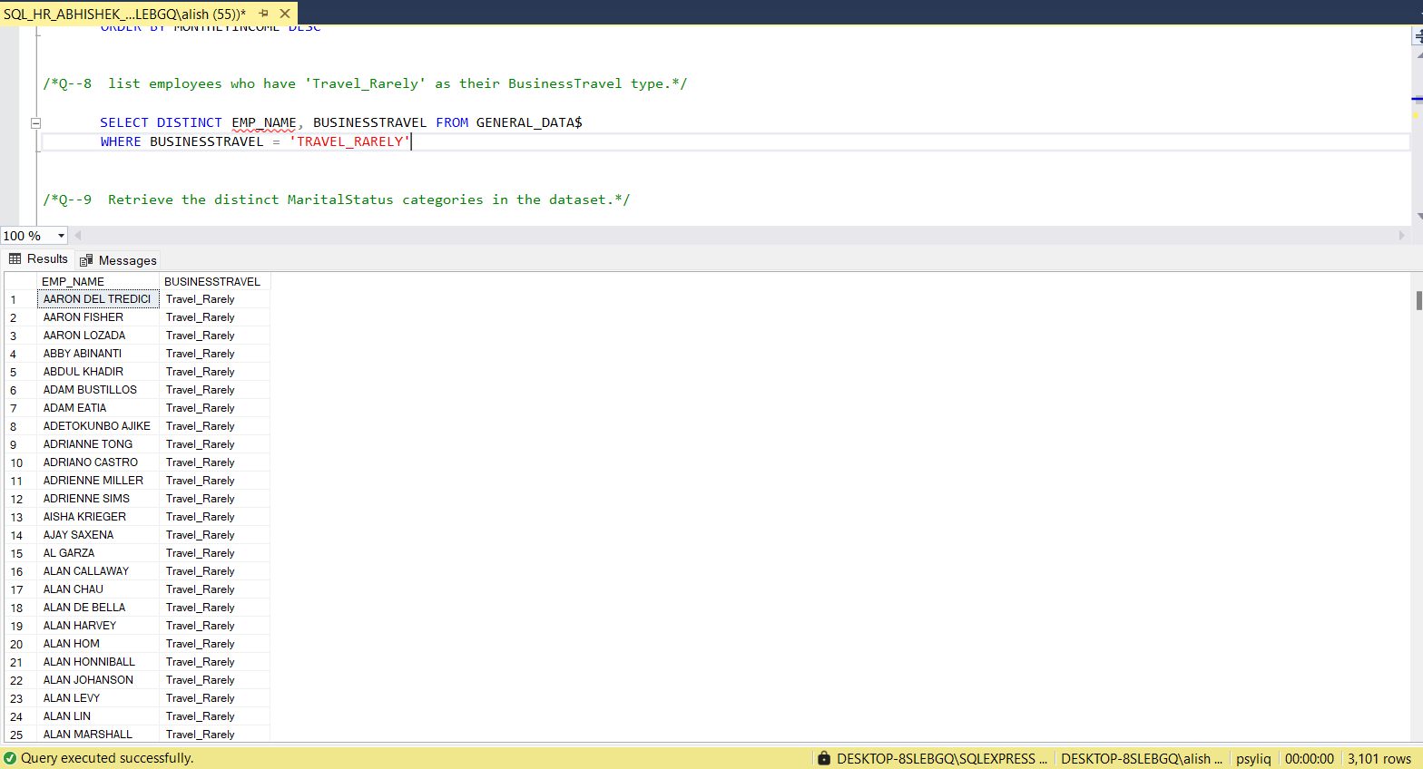
Q-8 List employees who have 'Travel_Rarely' as their Business Travel type.
3101 EMPLOYEES TRAVEL
RARELY FOR BUSINESS PURPOSE.

Slide 11
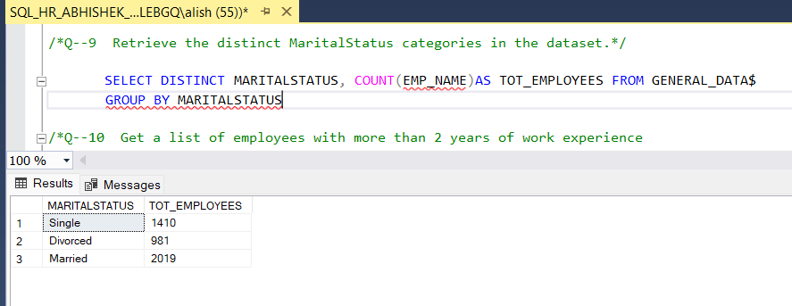
Q-9 Retrieve the distinct Marital Status categories in the dataset.
TOTAL EMPLOYEES IN EACH MARITAL STATUS CATEGORY.

Slide 12
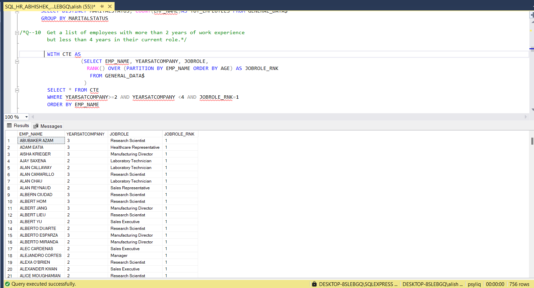
Q-10 Get a list of employees with more than 2 years of work experience
but less than 4 years in their current role.
TOTAL 756 EMPLOYEES HAVING
LESS THAN 4 BUT MORE THAN
2 YEARS EXP.

Slide 13
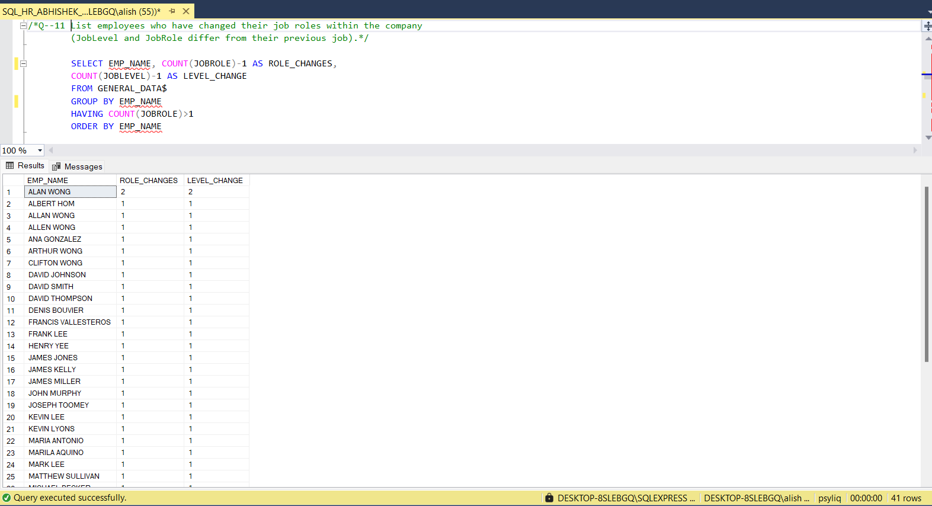
Q-11 List employees who have changed their job roles within the company (Job Level and Job Role differ from their previous job).
TOTAL 41 EMPLOYEES WHO HAVE EITHER CHANGED THE JOB LEVEL OR JOB ROLE FROM PREVIOUS.

Slide 14
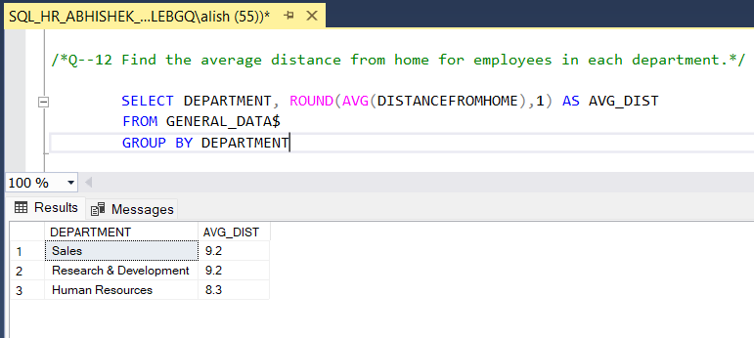
Q-12 Find the average distance from home for employees in each department.
DEPT WISE AVG DISTANCE FROM HOME
SALES -9.2
R&D -9.2
HR -8.3

Slide 15
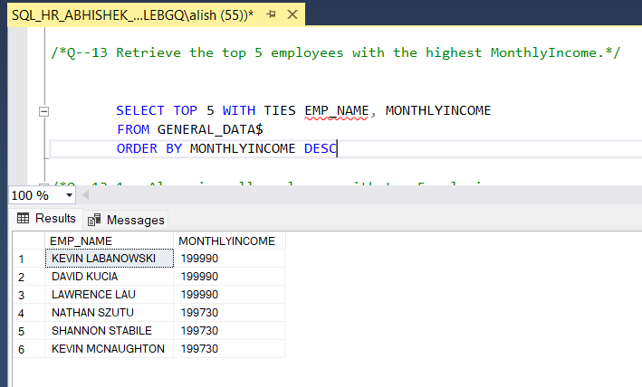
Q-13 Retrieve the top 5 employees with the highest Monthly Income.
TOTAL 6 EMPLOYEES WITH MAX SALARIES.

Slide 16
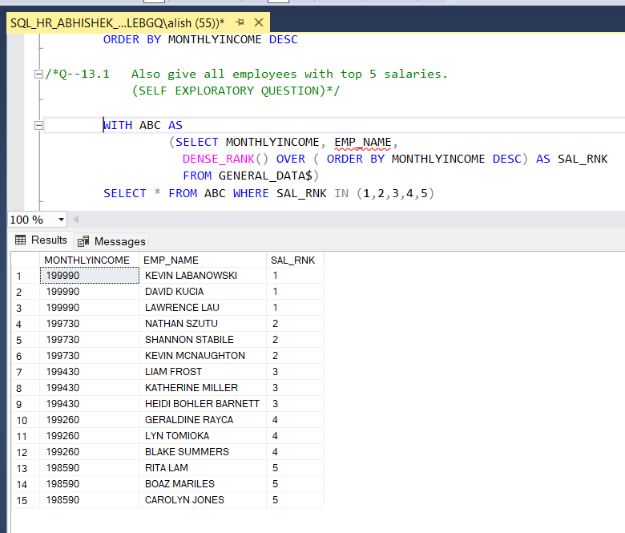
Q-13.1 (SELF EXPLORATORY) Retrieve all employees having top 5 highest Monthly Income.
THERE ARE 15 EMPLOYEES HAVING OR FALLING UNDER TOP 5 SALARY SLAB.

Slide 17
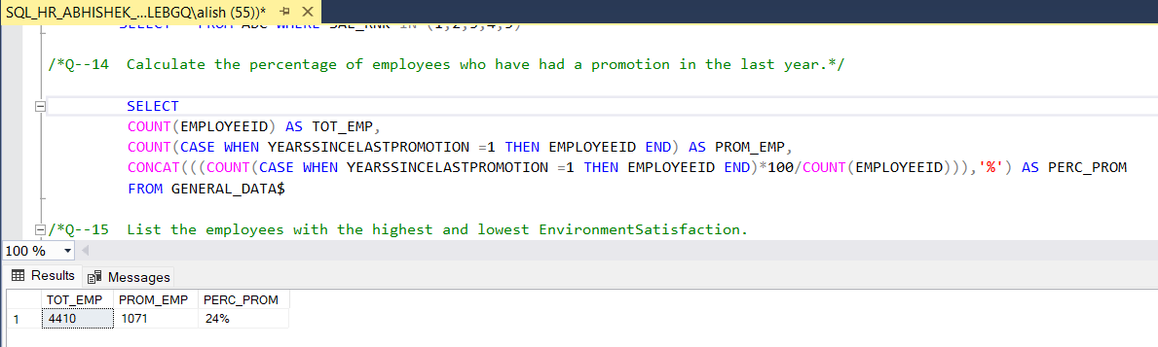
Q-14 Calculate the percentage of employees who have had a promotion in the last year.
24% EMPLOYEES OUT OF TOTAL WERE PROMOTED.

Slide 18
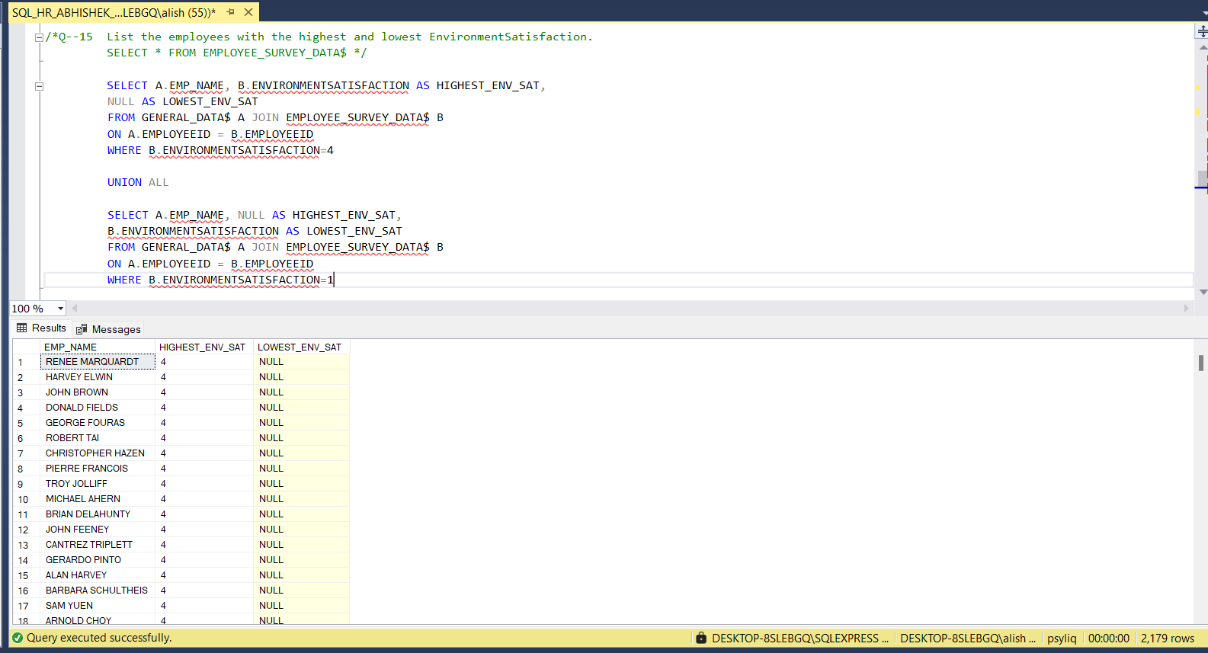
Q-15 List the employees with the highest and lowest Environment Satisfaction.
TOTAL 2179 EMPLOYEES ARE
THERE HAVING EITHER
LOWEST OR HIGHEST
ENVIRONMENT
SATISFACTION.

Slide 19
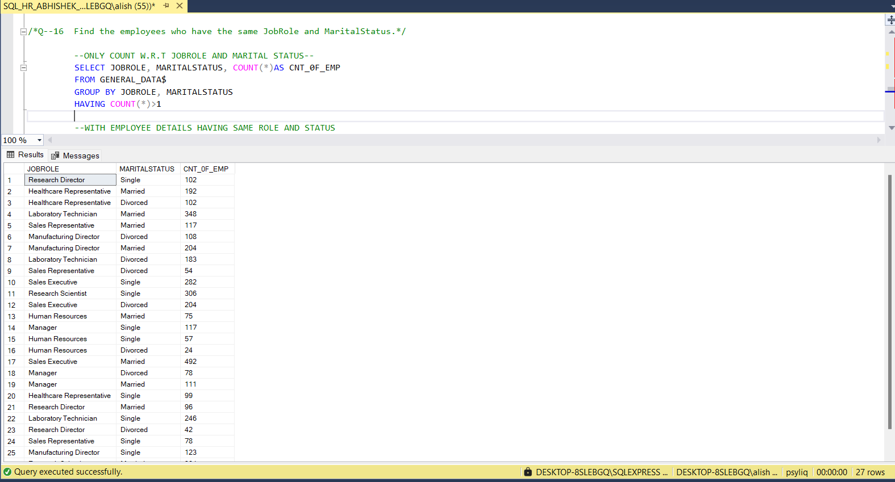
Q-16 Find the employees who have the same Job Role and Marital Status.
THERE ARE 27 COMBINATIONS
OF JOB ROLE AND MARITAL
STATUS AND COUNT OF
EMPLOYEES IN EACH
COMBINATION IS THERE

Slide 20
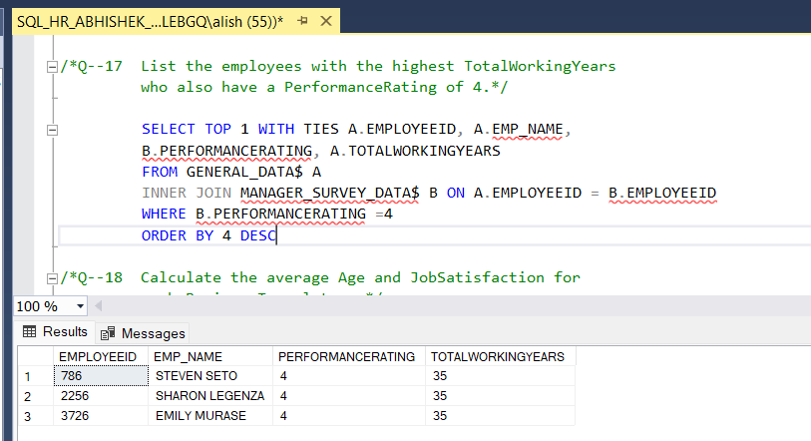
Q-17 List the employees with the highest Total Working Years who also have a
Performance Rating of 4.
3 EMPLOYEES ARE THERE WITH HIGHEST WORKING YEARS AND RATING ABOVE 4.

Slide 21
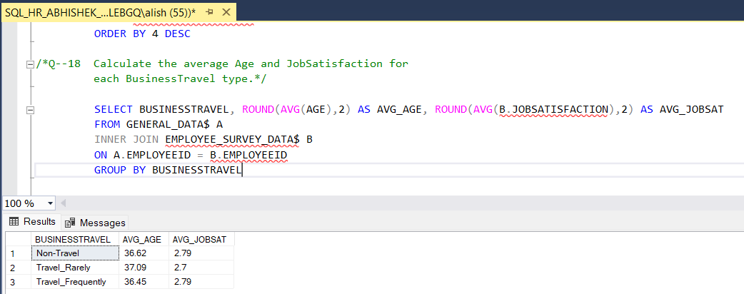
Q-18 Calculate the average Age and Job Satisfaction for each Business Travel type.

Slide 22
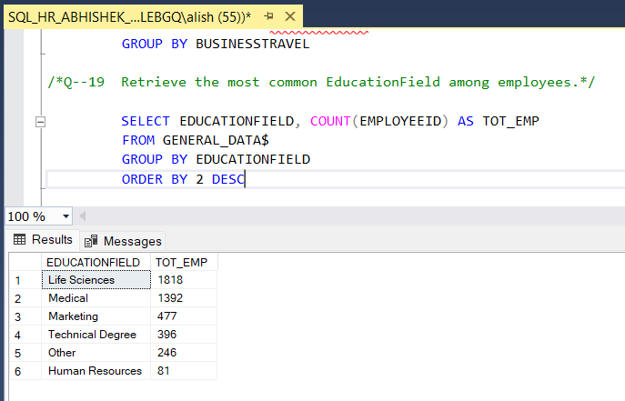
Q-19 Retrieve the most common Education Field among employees.
COUNT OF EMPLOYEES W.R.T EACH EDUCATION FIELD.

Slide 23
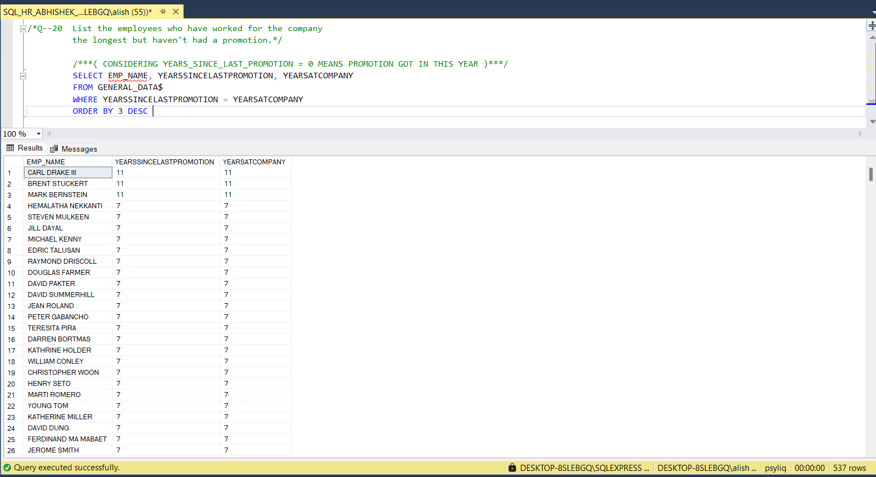
Q-20 Retrieve the most common Education Field among employees.
537 EMPLOYEES DID NOT GOT PROMOTION AND 3 HAVE WORKED FOR 11 YEARS WHICH IS MAX.

